Slide 1


Slide 2



Meet the team
Md Shafkat Faruk Khan
2022 - 3 - 60 - 035
Uswat Fatemee
2023 - 2 - 60 - 077
Maysha Iqra
2023-1-60-152

Slide 3
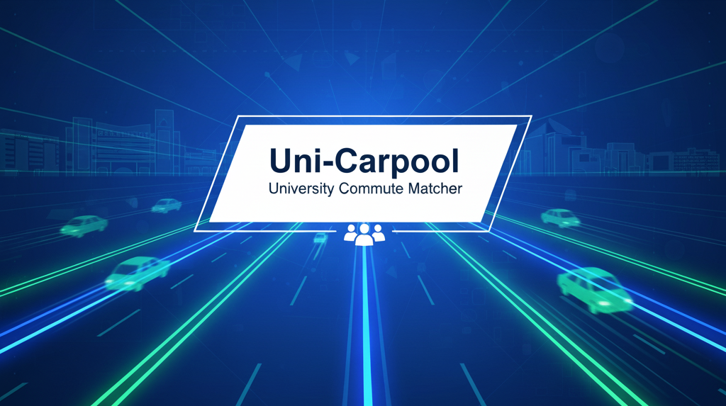

Slide 4
Motivation: Why Uni-Carpool?
Cost Efficiency
Non-Commercial Model
Affordable Commute
Guaranteed Trust & Security
Closed Community
Accountability
Sustainability & Efficiency
Reduces Congestion
Systematic Matching

Slide 5


Slide 6
Gaps in the System
The Trust and Security Gap
No Formal User Verification: Sharing platforms (social media, informal groups) lack necessary system checks. There is no official way to confirm if a driver/rider is a current, verified university affiliate.
The Economic & Cost Gap
Unsustainable Pricing Model: Commercial services (Uber/ Pathao) use dynamic pricing (surge) and add platform commissions, which makes the cost of daily commuting financially prohibitive for students
The Efficiency and Data Gap
Traffic-Inducing Schedules: The system relies on on-demand hailing rather than pre-scheduled matching for predictable routes, failing to organize collective demand to actually reduce congestion.
Zero Accountability:
Without a structured record-keeping system or formal rating process, there is no consequence for cancellations, no-shows, or poor behavior, leading to an inherently unreliable service.
Lack of Data Capture: No data is gathered on peak demand times, most requested routes, or congestion zones. This prevents the university from analyzing and making long-term logistical improvements to benefit the community.
Inefficient Cost Allocation: There is no easy mechanism to split the actual, non-profit fuel/CNG cost accurately and fairly among participants, which is the core financial goal of carpooling.

Slide 7


Slide 8
Segmented Matching
Must manage two distinct pools:
Car and Motorbike
Algorithm must apply capacity limits (1 rider for bikes) and user role segregation
Differentiated Cost
Cost logic must be non-commercial and transparent
Compensate motorbike drivers with a minimal fee; offer car drivers a full fuel offset
Enforce University ID/Email Verification for all users
Implement a mandatory, post-ride Rating System for accountability.
Guaranteed Trust
Performance & Reliability
Matching process must execute in under 10 seconds.
System must prevent double-bookings through robust database integrity checks.

Slide 9


Slide 10
Conclusion
Our analysis and design demonstrate superior strategic planning by:
Solving Local Gaps: Directly eliminates the need for expensive, surge-priced commercial apps by providing a secure, non-commercial alternative based on University Verification.
Adapting to Local Reality: Implements a two-tiered system (Car Pool and Motorbike Pool) with a Differentiated Cost Model, utilizing the dominant mode of student transport.
Creating Data: Transforms chaotic travel into structured data, enabling the University to make future data-driven logistical decisions to improve campus services.

Slide 11
Thank You

